Slide 1

Project name: Smart Pest Repeller
Team members: Andrew Albritton Michael McNeil
Melquisedec Ordonez

Slide 2
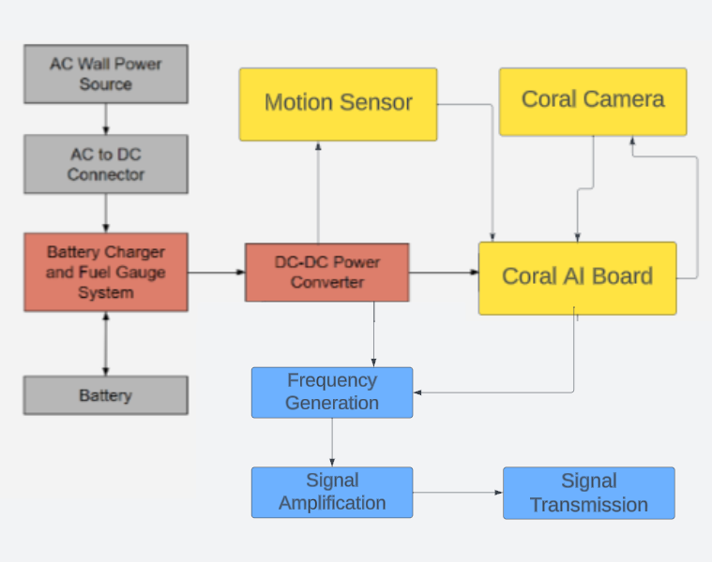
Team 30: Smart Pest Repeller
System Block Diagram:
Andrew Albritton: Yellow (ML Algorithm / Emitter Control)
Michael McNeil: Red / Grey (Power Delivery / Battery Charging)
Melquisedec Ordonez: Blue (Emitter Subsystem)

Slide 3
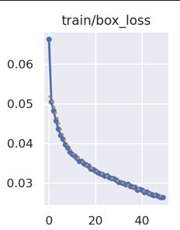
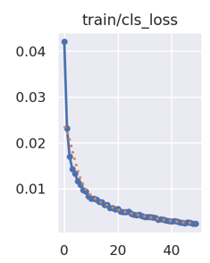
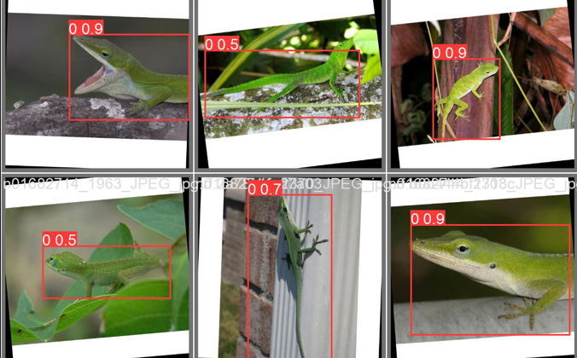
ML Algorithm / Control Andrew Albritton
Accomplishments since the last presentation 38 hrs 45 min | Ongoing progress/problems and plans until the next presentation
-training data acquired (9 classes and 9468 images labeled) -image resizing tool (any size to 640x640) -trained model (loss <= .02 and cls loss < .005) -detection testing (probability of detection varies) -model outputs found labels and probabilities of detection to .csv format for processing - Change model platform from pyTorch to Tensorflow Lite (coral board TPU compatible) | - Control program (image grab -> image processing -> .csv from model -> processing .csv -> send GPI/O control) - Camera / Motion sensor operation programs - Coral Board boot settings must be changed to immediately run control program

Slide 4
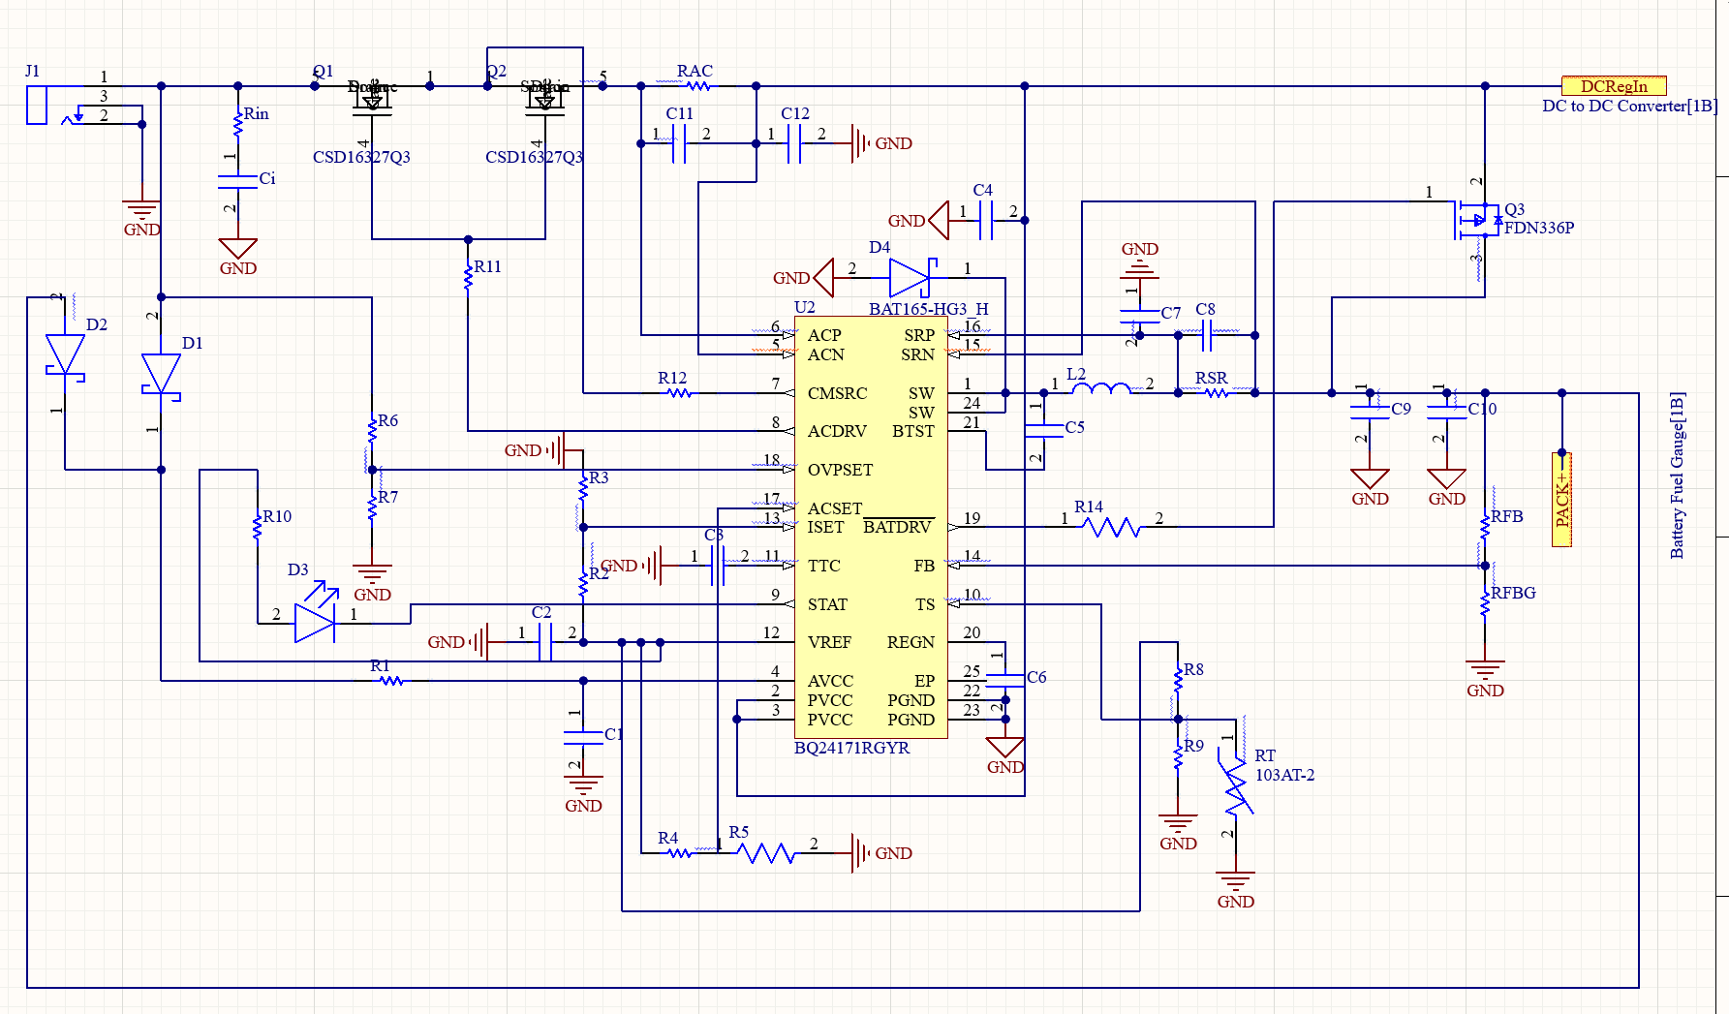
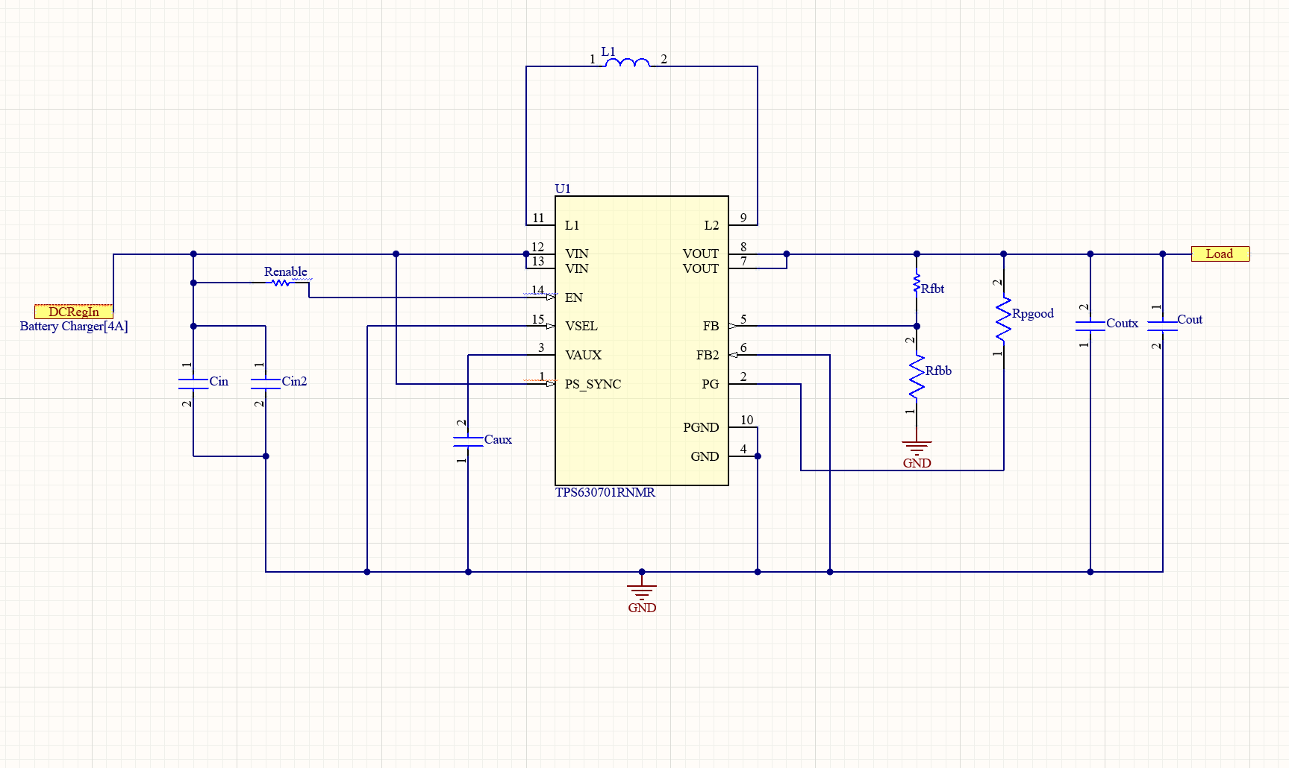
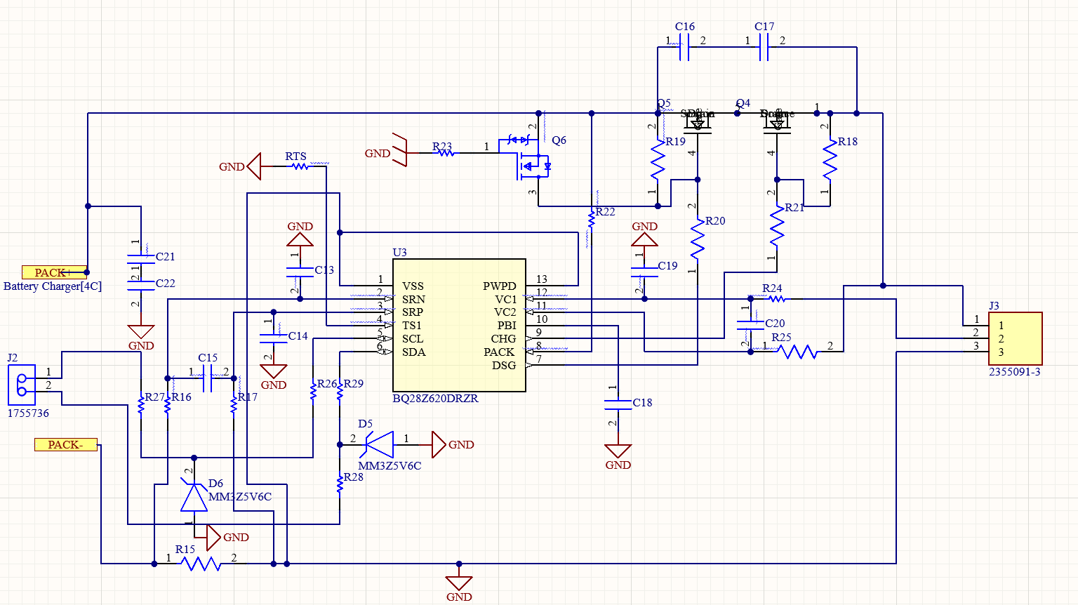
Power Supply PCB Michael McNeil
Accomplishments since the last presentation ~30 hrs | Ongoing progress/problems and plans until the next presentation
Power PCB parts selected Battery Charger schematic complete Battery Fuel Gauge schematic complete | Finish Placing and Routing PCB in Altium PCB assembly PCB Circuit testing

Slide 5
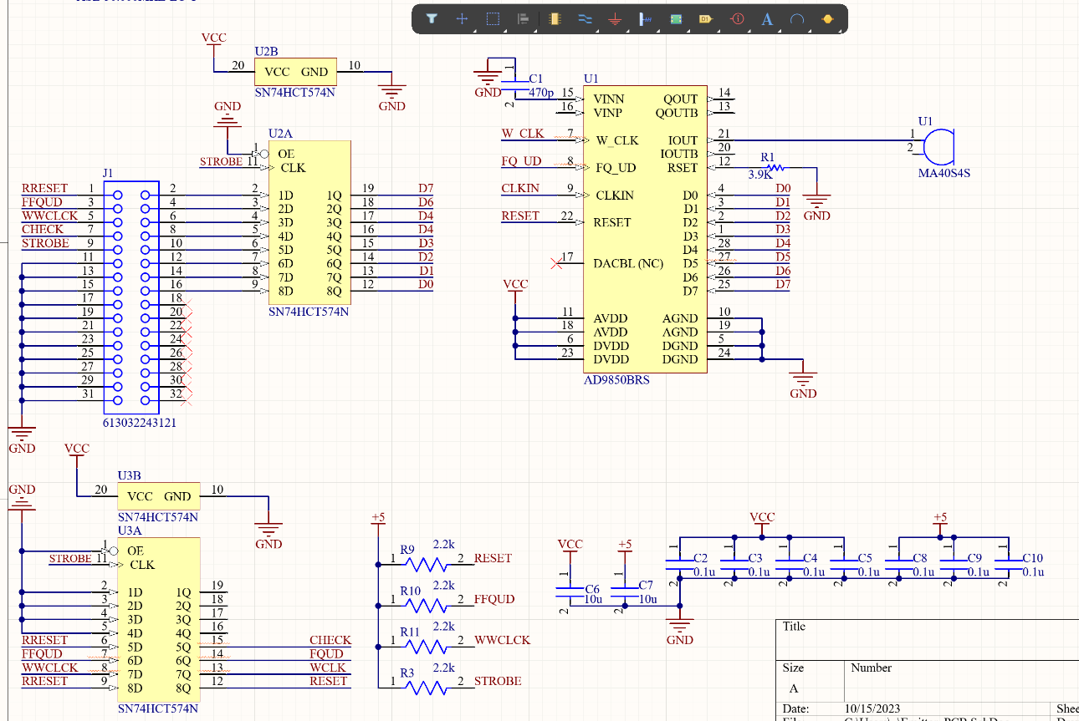
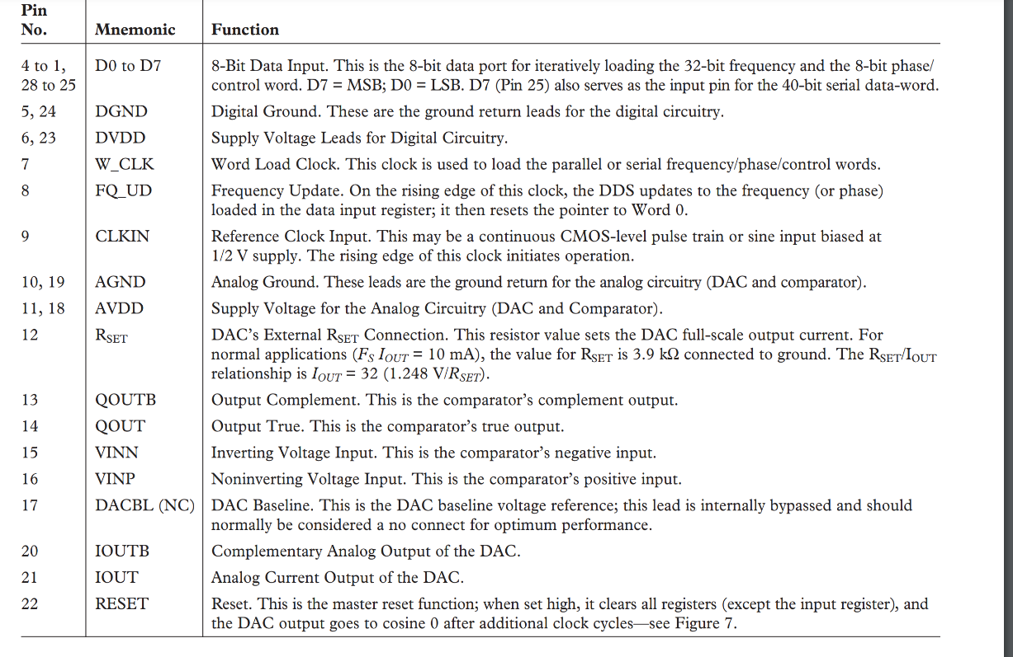
Signal Generator / Emitter
Melquisedec Ordonez
Accomplishments Since the last presentation ~20 Hrs | Ongoing progress/problems and plans until then next presentation
Signal Generator Schematic design complete Final Parts List complete | PCB design and routing Signal Generation and testing

Slide 6
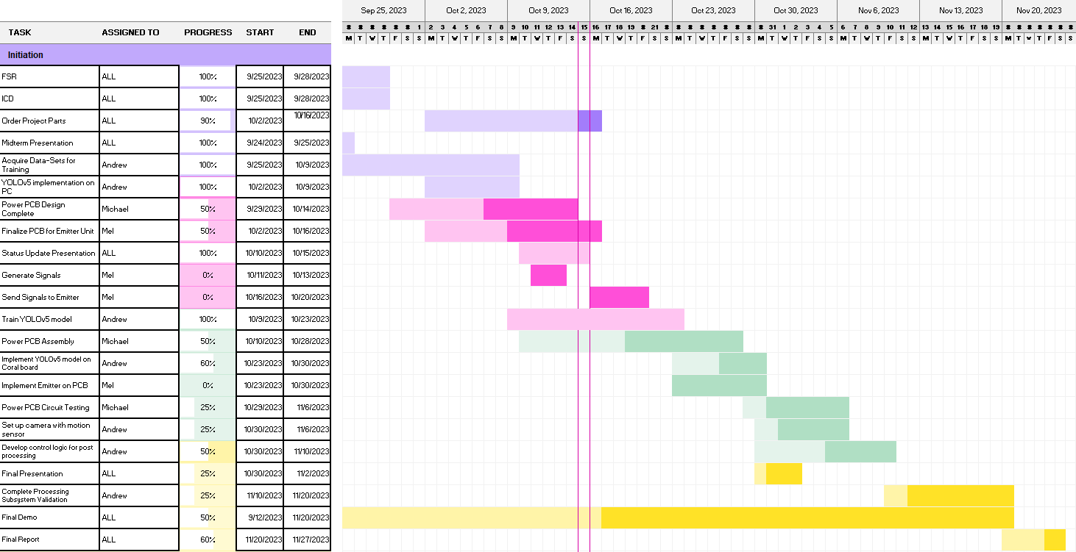
Team 30: Smart Pest Repeller - Schedule

Slide 7
Team 30: Smart Pest Repeller
Validation Plan
Task | Specification | Result | Owner
Training Verification | Goal of 90%>= precision or Goal of .1 >= loss | PASS | Andrew
Camera Verification | make sure 3 photos are taken per second |  | Andrew
Motion Verification | Ensure camera activates from motion control |  | Andrew
Camera MLA processing verification | Ensure precision is maintained post- implementation (Generalization of model usually yields 10-20% lower probability of detection) |  | Andrew
DC/DC Voltage Converter Verification | Verify that converter can take in various input voltages and continue to output 5V and 2A |  | Michael
Battery Charger Verification | Verify battery charger charges battery |  | Michael
Fuel Gauge Indicator Verification | Verify fuel gauge tracks fuel and indicates when batteries need to charge |  | Michael
Power PCB Verification | Verify PCB circuit connects and system functions as intended |  | Michael
Signal Verification | Establish signal generator can produce the three separate frequencies required |  | Mel
Amplifier Verification | Verify signal is appropriately amplified before reaching emitter |  | Mel
Emitter verification | Make sure emitter can emit required frequencies |  | Mel
Emitter PCB verification | Verify circuit behaves like individually verified componentes did |  | Mel

